Slide 1
Source Code
Version Control

Slide 2
Objectives
What is Version Control System
Introduction to Git
Create Repository
Inviting Collaborators
Commit
Push
Pull
Sync
Conflict resolution

Slide 3
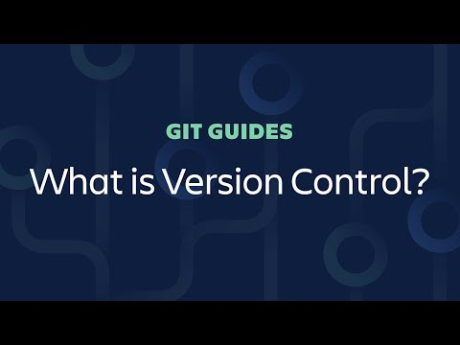
What is Version Control?
Source: https://www.youtube.com/watch?v=xQujH0ElTUg

Slide 4
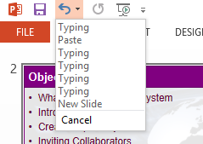
What is Version Control System
Version control systems are software that manages changes to source codes over time
Multiple developers can work on the same project, and creates different versions or snapshot of the source codes at certain point in time.
Allows developers to switch between these versions or rollback to earlier versions
VCS is like the undo functions
in Microsoft Word or
Microsoft PowerPoint

Slide 5






What is Version Control System
There are various standards, e.g. SVN, Git, Mercurial
Popular service provider, e.g. GitHub, Bitbucket, TortoiseSVN

Slide 6
Introduction to Git
Git is a distributed version control with an emphasis on speed, data integrity, and support distributed workflows
GitHub and BitBucket are web-based VCS using Git
For the purpose of PRG2, register an account with BitBucket using your NP email address

Slide 7
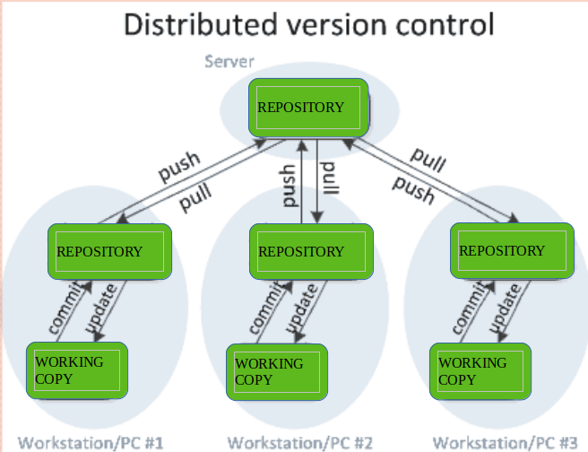
Introduction to Git
Source: https://www.geeksforgeeks.org/version-control-systems/

Slide 8
In a nutshell
All your project source files are stored on the cloud, also known as remote Repository.
Every developer working on the same project will clone the remote Repository to local computer known as local Repository.
Each time you would like to save or create a checkpoint in the local computer, the action is known as Commit.
Each time you would like to save the new commits to the cloud, the action is known as Push
Each time you would like to retrieve updates from the cloud, you would do Pull
If you would like to undo the changes, you would do a Revert

Slide 9
Terminology for Git
Terms | Definition
Repository | Contains the history of a collection of files in a directory
Clone | Copies an existing Git repository into your computer
Commit | Saves the current snapshot into local repository
Push | Saves the changes into the Git repository
Pull | Merge the changes from Git repository into local files since last merge
Sync | Do a Push and a Pull
Revert | Undo changes of a snapshot

Slide 10
Slides 12 to 27 narrates the steps required to perform the respective Git actions
Slides | Actions | Team Leader | Team Member
12 | Create Git Repository | ☑
13 – 15 | Starting an empty repository | ☑
16 | Inviting collaborators | ☑
17 – 19 | Clone repository |  | ☑
20 | Commit changes | ☑ | ☑
21 – 22 | Push to repository | ☑ | ☑
23 | Pull from repository | ☑ | ☑
24 – 27 | Resolve conflicts | ☑ | ☑

Slide 11
Activity
Register an account with BitBucket using your NP email address: https://bitbucket.org/account/signup/
Create a repository on BitBucket for your Week 4 Practical project
Follow the steps in the following slides to
  Create a GIT repository
  Start an empty repository with your Week 4 practical project
  Inviting your PRG2 tutor as your collaborators
Deadline: End of the week, Sunday (2359hr)

Slide 12
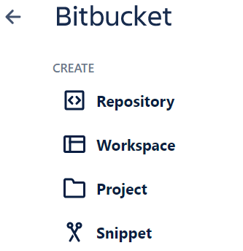

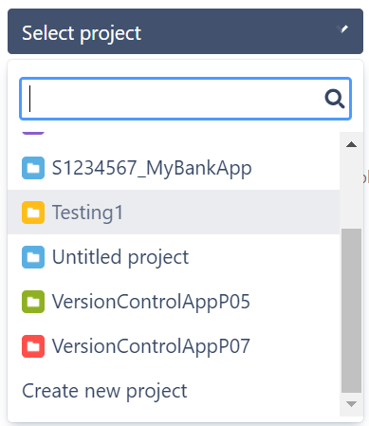


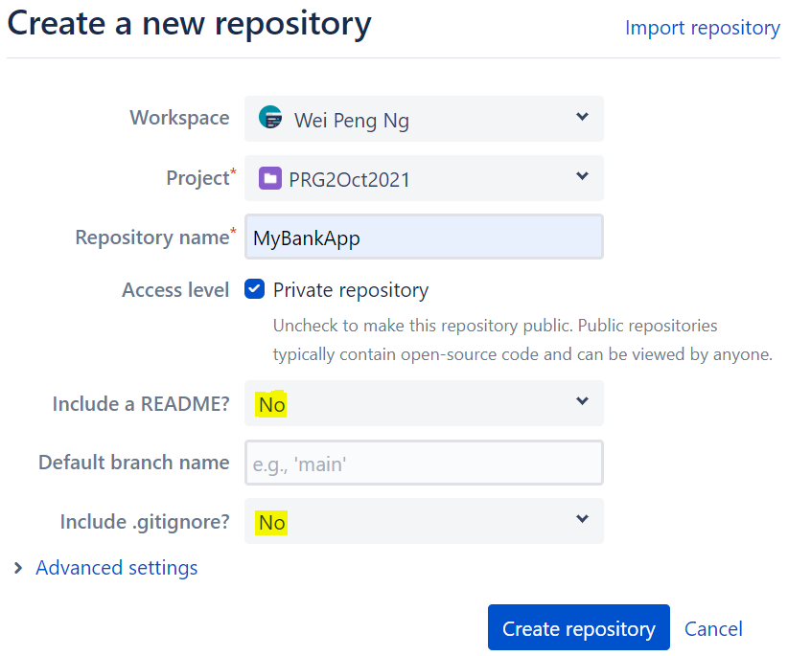

Create Git Repository
Click on > Repository in BitBucket
Click on
Scroll down and click on
Enter your Project & Repository name,
and follow the screen shot
for the rest of the fields
Make sure that “Include a
README?” & “Include
.gitignore?” are set to No.
Click on
A new empty repository will
be created.

Slide 13
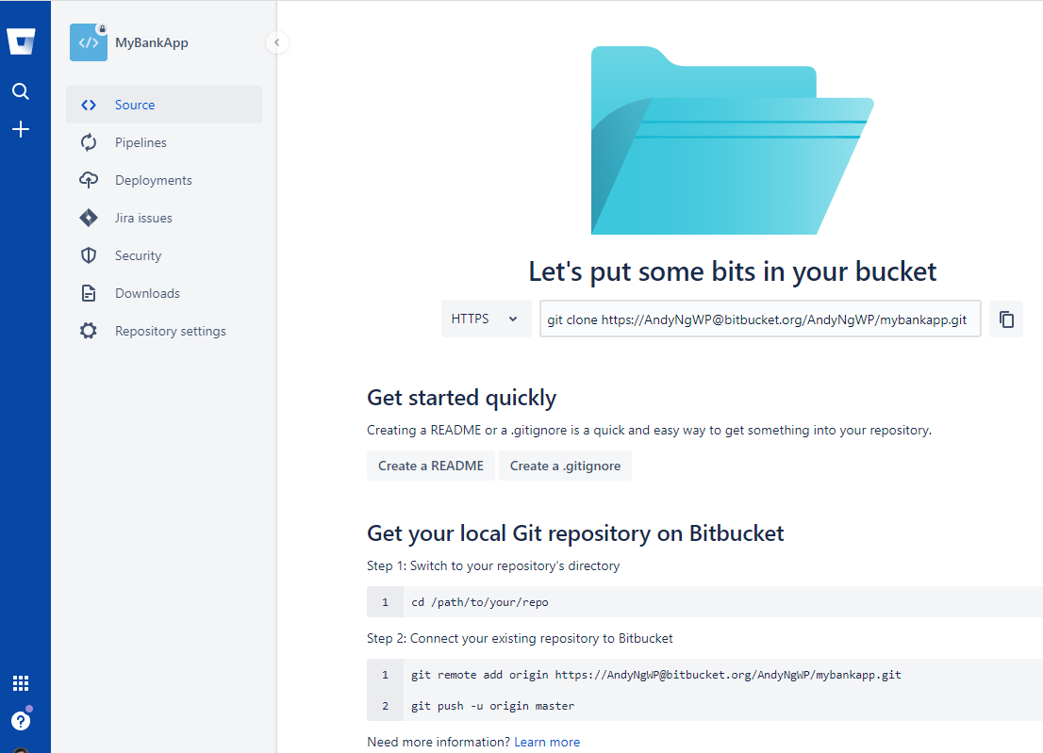


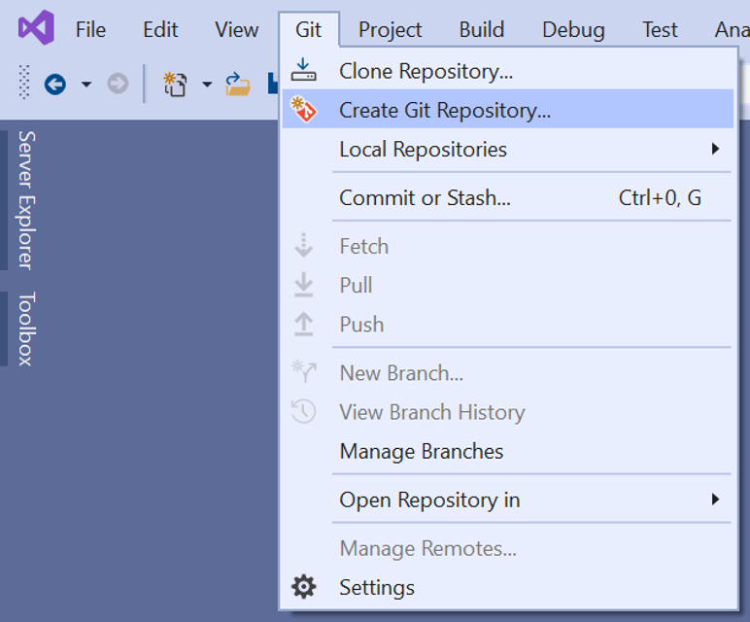
Starting an empty repository (1/3)
Get the URL of your repository
from the Bitbucket repository
page.
In Visual Studio, create or
open existing C# console
project.
On the menu bar, click on
and
Notes:
This steps are required only for initialising the empty repository with a project
And to be done by Student #1

Slide 14
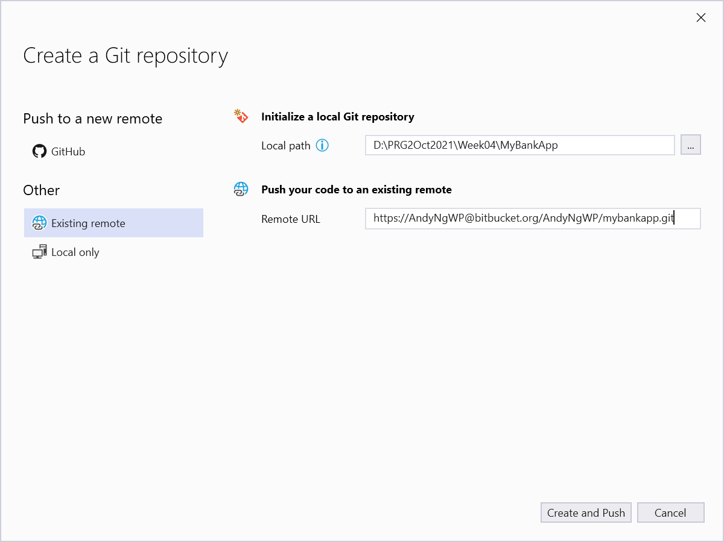
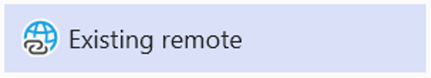

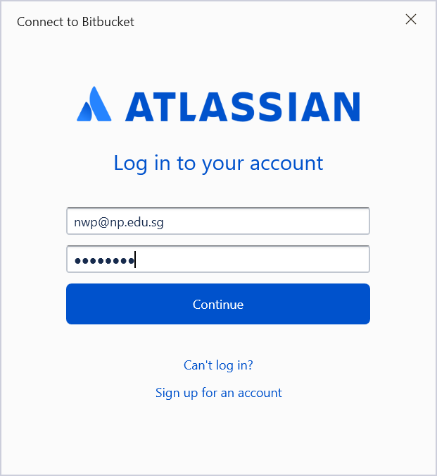
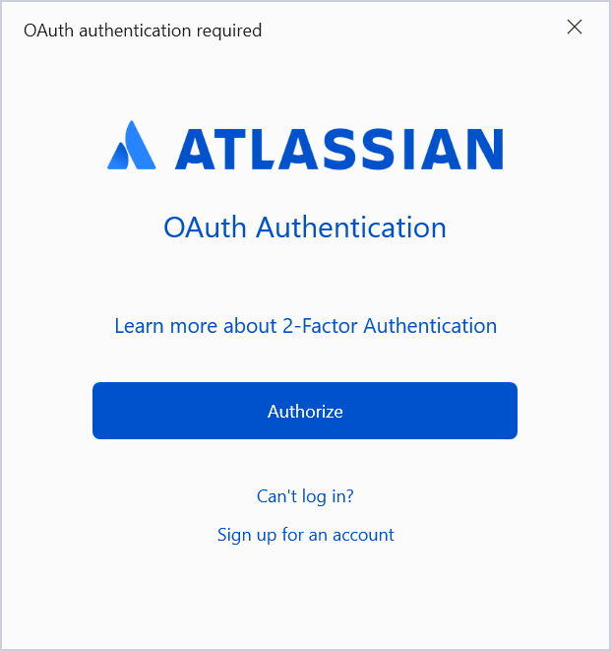


Starting an empty repository (2/3)
Click on , enter
the URL of your repository in the
and click on
You may be asked to login to
Bitbucket if you are pushing your
code for the first time. Enter
your Bitbucket username / email
& password, click on
Another pop-up window will
appear, click on

Slide 15
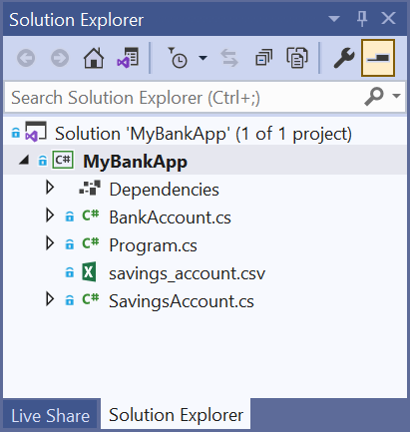

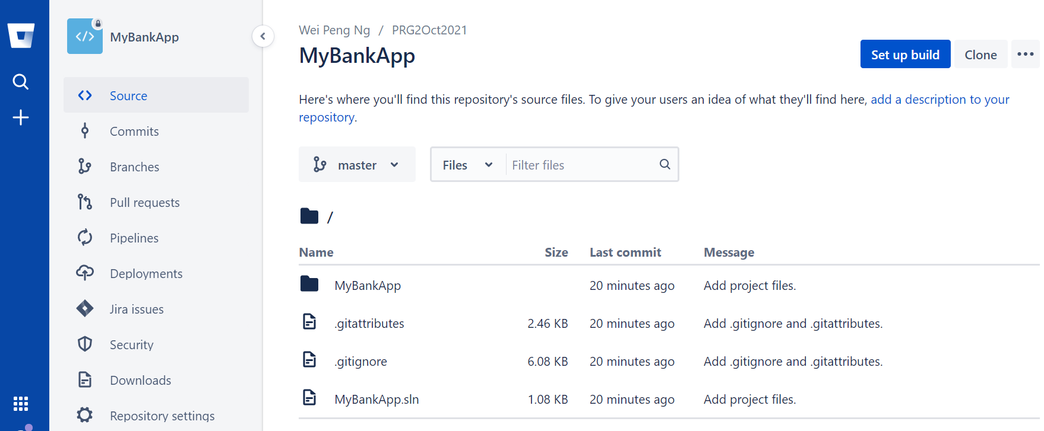
Starting an empty repository (3/3)
Now you will see in your Solution
Explorer that on each file and folder, a
new blue lock is shown. This verifies
that a local git repository is created.
Go to Bitbucket portal and refresh, all
the codes are pushed to the remote
git repository.
Now your remote git
repository is ready
to be shared to
other developers.

Slide 16
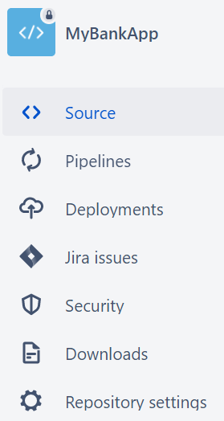



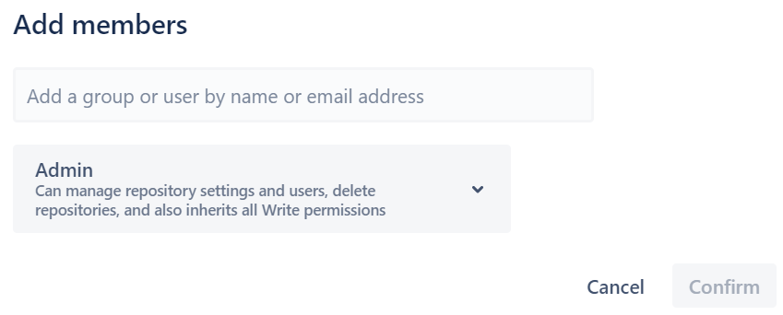

Inviting collaborators
Go to your repository in BitBucket
Click on
Click on
Click on
Enter the email addresses of your teammates and
tutor in the textbox
provided, and grant
them Admin access.
Click on

Slide 17

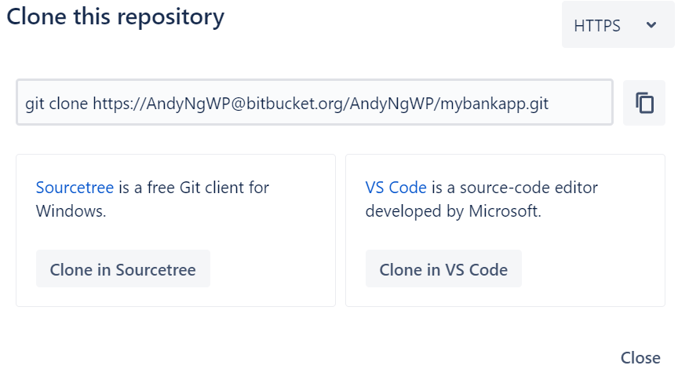
Clone repository (1/3)
In Bitbucket portal, open the repository that you want to clone. Click on
Copy URL of the repository to be cloned.
Notes:
Cloning to be done by Student #2

Slide 18
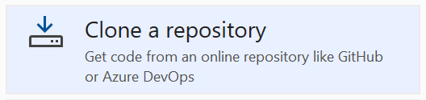
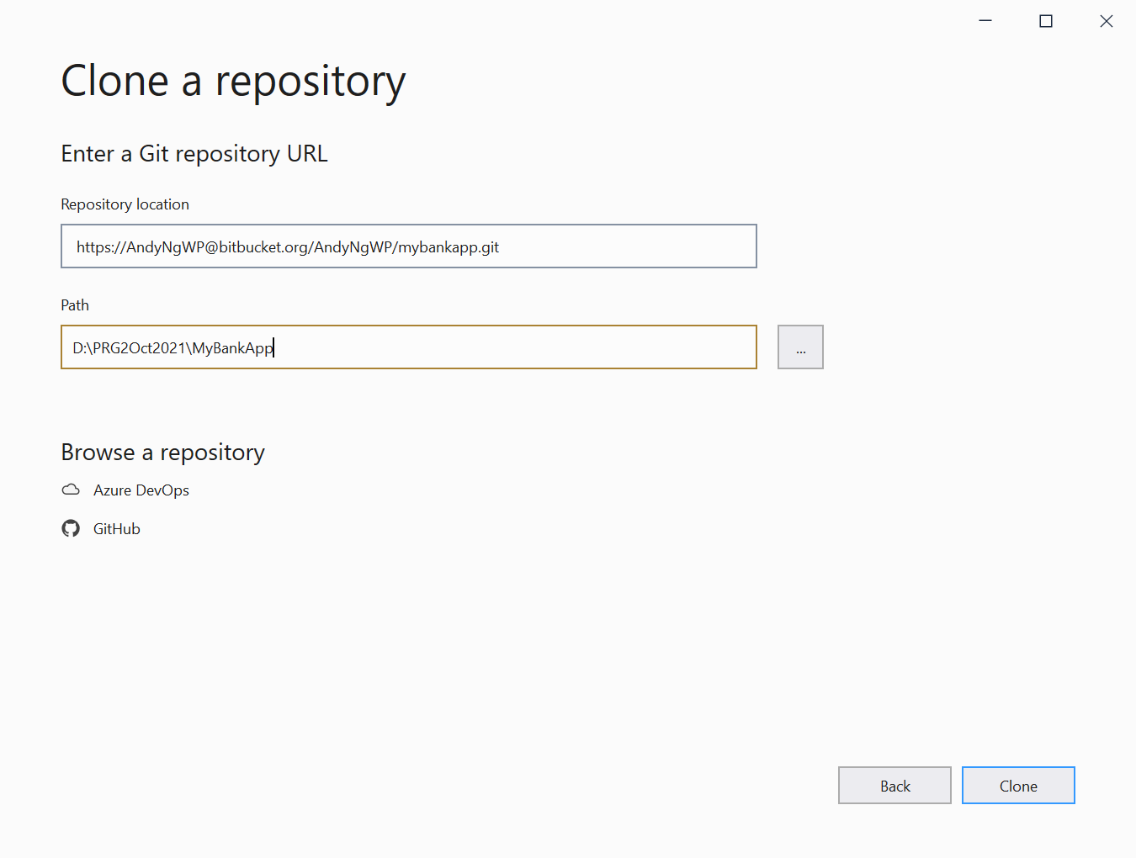


Clone repository (2/3)
Launch Visual Studio, click on
Enter the URL of repository
to be cloned in the textbox.
You may change the directory
to save the project by clicking
on . This directory must be
an empty directory.
Click on
Notes:
Cloning to be done by Student #2

Slide 19
Clone repository (3/3)
You may be asked to login to Bitbucket. Enter your Bitbucket username / email & password and click on
Another pop-up window will appear, click on
You can start working on the code now.
Notes:
Cloning to be done by Student #2

Slide 20
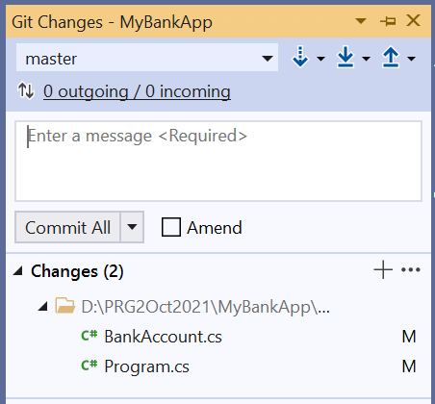
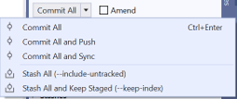
Commit changes
Visual Studio will show the number of files have been modified since last commit.
Click on the pencil icon to launch
the Git Changes panel
All the files that have been
modified will be listed here. Enter
the message that describes these
changes, and click

Slide 21
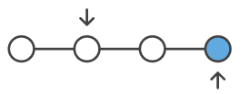
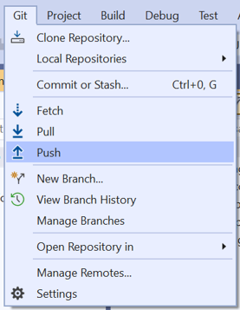
Push to repository (1/2)
If there are local commits not pushed to the remote git repository, Visual Studio will show the number of unpushed commits.
Click on > in the
main menu to send the changes
to remote git repository.
Remote git repository
Your computer

Slide 22

Push to repository (2/2)
Now these changes will be available
to all other developers.
You can click on to view the local commits history.

Slide 23
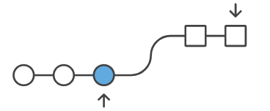
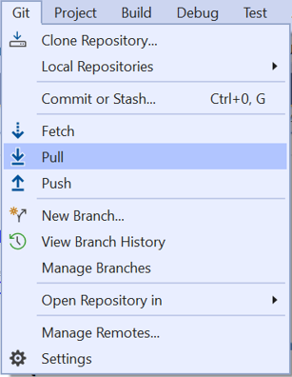

Pull from repository
Git repository
To retrieve the latest changes from
remote git repository, click >
in the main menu.
The changes will be merged into
your codes.
It is always a good practise to pull the
code first before make your changes to
avoid losing the code changes made by
your team members.
Your computer

Slide 24
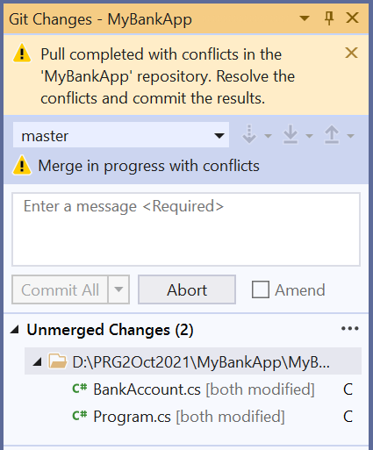
Resolve conflicts (1/4)
It is possible that different developers worked on the same segment of codes and tried to push the changes to the Git repository.
If this scenario happens, the
latest push to Git repository will
encounter a Conflict.

Slide 25
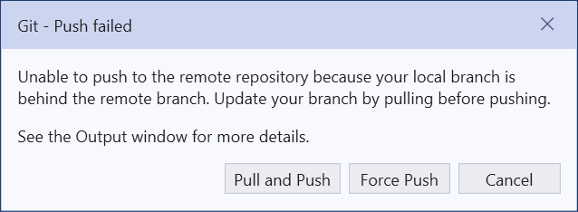


Resolve conflicts (2/4)
When conflicts occur, a
Git – Push failed window
will appear. Click on
The Git Changes window shows a list
of program files with conflicts under
Unmerged Changes.
Repeat the following steps for every
program file with conflicts.
To resolve conflicts, double-click on
the program file in the list under
Unmerged Changes to open
Merge Editor. If program file is opened,
click on

Slide 26
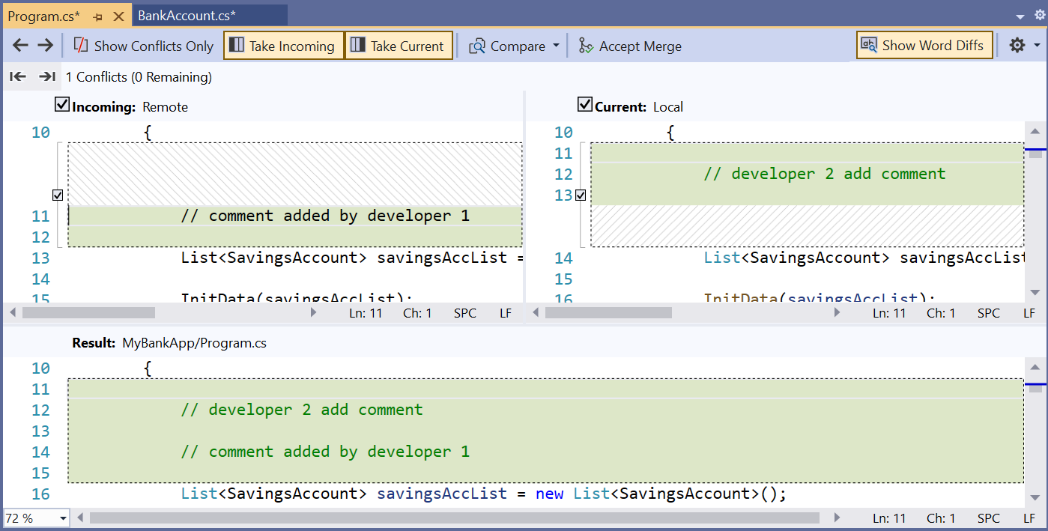
Resolve conflicts (3/4)
In the Merge Editor, the 2 windows at the top shows the source code from both the cloud (remote repository) and local computer (local repository).
A checkbox will appear
besides each segment
of code that is having
conflict.
The window below shows the merged file. Check on the segment of code to keep in the merged file. You may make further changes in this window.

Slide 27

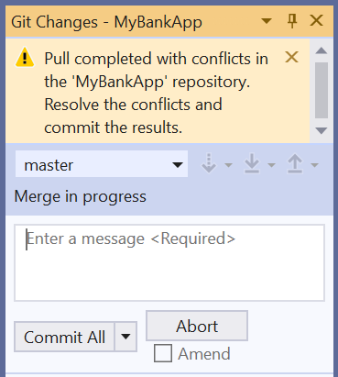
Resolve conflicts (4/4)
Click on button, located on the top.
After resolve all conflicts in the program files,
go to Git Changes panel,
enter a message and
click on ..
This will push the merged
changes to remote repository.

Slide 28
Activity (Reminder)
Register an account with Bitbucket using your NP email address: https://bitbucket.org/account/signup/
Create a repository on Bitbucket for your Week 4 Practical project
Follow the steps in the following slides to
  Create a GIT repository
  Start an empty repository with your Week 4 practical project
  Inviting your PRG2 tutor as your collaborators
Deadline: End of the week, Sunday (2359hr)

Slide 29
Reading Reference
What is version control –
https://www.atlassian.com/git/tutorials/what-is-version-control
Git Tutorial – https://www.tutorialspoint.com/git/index.htm
Workflow - https://www.atlassian.com/git/tutorials/comparing-workflows

Slide 30
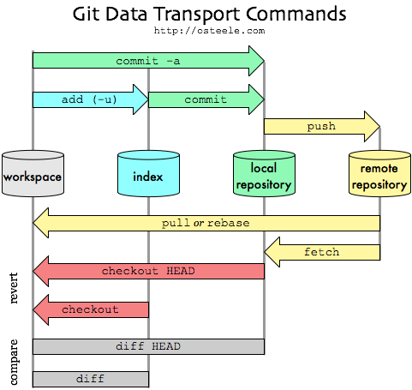
Git Data Transport Command
Notes:
https://stackoverflow.com/questions/292357/what-is-the-difference-between-git-pull-and-git-fetch

Slide 31
Summary
Essentials of GIT:
  Repository
  Clone
  Commit
  Push
  Pull
  Sync

